Slide 1
ICS 141 – Programming With Objects
Lecture 1 – Robert Jahn

Slide 2
Schedule
Intro + Syllabus
Java Intro
Primitive Types Vs Reference Types
Exercise 1a
Break
Reading in User Input
Exercise 1b
Setting up a Java Environment/Working with Eclipse
Survey (Not worth any points) + Break
Assignment #1
Lab #1

Slide 3
Syllabus
Open Syllabus ~

Slide 4
Survey
Worth no points.
Will have absolutely no impact on your grade.
Simply a way for me to get an idea of your individual programming experience.

Slide 5
Java Intro
Writing a Java program
Anatomy of a Java program
Primitive types
Declaring/Assigning variables
Constants
Strings
Printing to the command line
Conventions in java

Slide 6
Writing a Java Program
Java, at its core, is an object-oriented language. That is, no matter what our goals are, we have a situation where we’ll always have to create a class to run our programs.
Within our class definitions, we’ll include a special method.
The main method.
This is where the execution of our programs begins.
Later, we’ll have solutions that span many classes. We’ll generally only include one main method in exactly one of these files. This way, we’ll have only one possible entry point when it comes to executing a large solution.
So, in writing our Java programs, we’ll always start with a class definition and a main method.

Slide 7
Anatomy of a Java Program
Class name
Main method
Statements
Statement terminator
Reserved words
Comments
Blocks

Slide 8
Class Name
Every Java program must have at least one class. Each class has a name. By convention, class names start with an uppercase letter. In this example, the class name is Welcome.
//This program prints Welcome to Java!
public class Welcome {
public static void main(String[] args) {
System.out.println("Welcome to Java!");
}
}

Slide 9
Main Method
Line 2 defines the main method. In order to run a class, the class must contain a method named main. The program is executed from the main method.
//This program prints Welcome to Java!
public class Welcome {
public static void main(String[] args) {
System.out.println("Welcome to Java!");
}
}

Slide 10
Statement
A statement represents an action or a sequence of actions. The statement System.out.println("Welcome to Java!") in the program is a statement to display the greeting "Welcome to Java!“.
//This program prints Welcome to Java!
public class Welcome {
public static void main(String[] args) {
System.out.println("Welcome to Java!");
}
}

Slide 11
Statement Terminator
Every statement in Java ends with a semicolon (;).
//This program prints Welcome to Java!
public class Welcome {
public static void main(String[] args) {
System.out.println("Welcome to Java!");
}
}

Slide 12
Reserved words
Reserved words or keywords are words that have a specific meaning to the compiler and cannot be used for other purposes in the program. For example, when the compiler sees the word class, it understands that the word after class is the name for the class.
//This program prints Welcome to Java!
public class Welcome {
public static void main(String[] args) {
System.out.println("Welcome to Java!");
}
}

Slide 13
Blocks
A pair of braces in a program forms a block that groups components of a program.

Slide 14
Special Symbols

Slide 15
{ … }
// This program prints Welcome to Java!
public class Welcome {
public static void main(String[] args) {
System.out.println("Welcome to Java!");
}
}

Slide 16
( … )
// This program prints Welcome to Java!
public class Welcome {
public static void main(String[] args) {
System.out.println("Welcome to Java!");
}
}

Slide 17
;
// This program prints Welcome to Java!
public class Welcome {
public static void main(String[] args) {
System.out.println("Welcome to Java!");
}
}

Slide 18
// …
// This program prints Welcome to Java!
public class Welcome {
public static void main(String[] args) {
System.out.println("Welcome to Java!");
}
}

Slide 19
" … "
// This program prints Welcome to Java!
public class Welcome {
public static void main(String[] args) {
System.out.println("Welcome to Java!");
}
}

Slide 20
Keep in Mind
We must always name our java file for the class that appears within the file.
There can only be one public class defined in each file.
This is done for efficient compilation of your programs.
Keeping track of your class definitions becomes easier.

Slide 21
Primitive Types
In ICS 140, or in your transfer equivalent, you likely have used primitive data types (although you may not have realized this in the Python language).
In java, we have 8 primitive types available to us.
byte
short
int
long
float
double
boolean true/false
char ‘a’, ‘b’, ‘c’, ‘A’, ‘5’, ‘!’

Slide 22
Primitive Types
In Python, we had what are called dynamic types.
We do not declare variable types upon creating a new variable.
x = 5
x = “Hello”
Initially, x is of the int type, then it is of the String type.
We cannot do this in Java.
Instead, we explicitly declare the type upon variable creation.
int x = 5;
String y = “Hello”;
These are known as static types.
Note the terminating ‘;’
The semicolon terminates statements in java.

Slide 23
Primitive Types

Slide 24
Declaring Variables
int x; // Declare x to be an
// integer variable;
double radius; // Declare radius to
// be a double variable;
char a; // Declare a to be a
// character variable;

Slide 25
Assignment Statements
x = 1; // Assign 1 to x;
radius = 1.0; // Assign 1.0 to radius;
a = 'A'; // Assign 'A' to a;

Slide 26
Declaring and Initializing in One Step
int x = 1;
double d = 1.4;

Slide 27
Named Constants
final datatype CONSTANTNAME = VALUE;
final double PI = 3.14159;
final int SIZE = 3;

Slide 28
The String Type
The char type only represents one character. To represent a string of characters, use the data type called String. For example,
String message = "Welcome to Java";
String is actually a predefined class in the Java library. The String type is not a primitive type. It is known as a reference type. Any Java class can be used as a reference type for a variable. Reference data types will be thoroughly discussed in Chapter 8, “Objects and Classes.” For the time being, you just need to know how to declare a String variable, how to assign a string to the variable, and how to concatenate strings.

Slide 29
Strings, 2.18
Declaring and initializing in two steps.
String s1;
s1 = “Hello”;
Declaring and initializing in one step.
String s1 = “Hello”;

Slide 30
String Concatenation, 2.18
We concatenate, or combine, Strings using the ‘+’ operator. When used with numerical values, ‘+’ operates as a normal addition operator. However, when used with Strings, it is instead a concatenation operator.
String s1 = “Hello” + “ “ + “World”; //s1 = “Hello World”
When using the ‘+’ with numerical values and Strings, it operates as a concatenation.
String s2 = “hello” + 1 + 2 + 3; //s2 = “hello123”

Slide 31
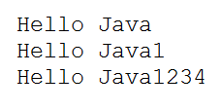
Strings, 2.18

Slide 32
String Concatenation
// Three strings are concatenated
String message = "Welcome " + "to " + "Java";
// String Chapter is concatenated with number 2
String s = "Chapter" + 2; // s becomes Chapter2
// String Supplement is concatenated with character B
String s1 = "Supplement" + 'B'; // s1 becomes SupplementB

Slide 33
Printing to the Command Line
We’ll use print and println methods to print to the command line.
System.out.print();
System.out.println();
The Python equivalent is the print() function.
We’ll pass Strings to these methods.
System.out.print(“Hello World”);
System.out.println(“Hello “ + “Bob”);
String str = “Bob”;
System.out.println(str);

Slide 34
Printing to the Command Line
We also have available the printf method. Useful if we want to allow further formatting.
Follows quite closely the c style
double total = 5.5;
System.out.printf("Total is: $%.2f", total);
“Total is $5.50”

Slide 35
Naming Conventions
Choose meaningful and descriptive names.
Variables and method names:
Use lowercase. If the name consists of several words, concatenate all in one, use lowercase for the first word, and capitalize the first letter of each subsequent word in the name. For example, the variables radius and area, and the method computeArea.

Slide 36
Naming Conventions, cont.
Class names:
Capitalize the first letter of each word in the name. For example, the class names Dog, Cat, and UniversitySystem.
Constants:
Capitalize all letters in constants, and use underscores to connect words. For example, the constant PI and MAX_VALUE

Slide 37
Comments
As you mature as programmers, you’ll be expected to document your code.
Part of this is including comments in the actual source code.
Your source files should include header comments.
This is a large comment that includes your name as well as basic idea behind the source code.
Additionally, you should include comments throughout the code itself.
Use comments to explain methods and classes.
Also use them to explain any code that is not straight-forward.

Slide 38
Indents/Whitespace
Many different organizations will have different standards when it comes to indents/whitespace.
Indents are horizontal space.
Whitespace is vertical space.
For our purposes, I only ask that you be consistent throughout your solutions.
If you use four-space indents at one point, do not switch to three-space indents later on.

Slide 39
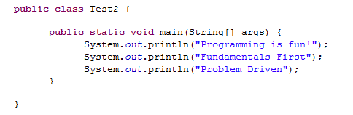
Good Indents Example

Slide 40
Keep in Mind
Indents were absolutely critical in Python.
The logic of the programs depend on the indents.
This is not the case in Java.
Indents only serve to maintain readability in the code. You could write an entire Java program on one line and it would still work.

Slide 41
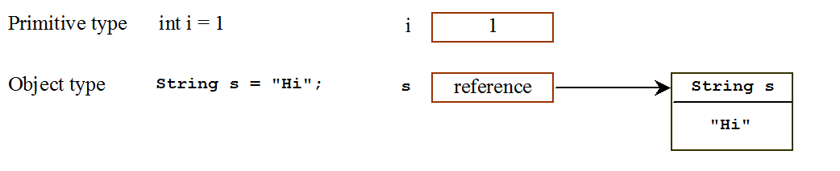
Differences between Variables of Primitive Data Types and Object Types

Slide 42
Copying Variables of Primitive Data Types and Object Types

Slide 43
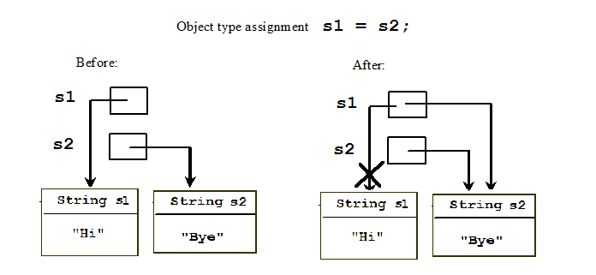
Copying Variables of Primitive Data Types and Object Types

Slide 44
Exercise 1a

Slide 45
Reading in User Input
We’ve seen how we might set variable values in our programs.
This is useful; however, we need to have the ability for the user to enter his own data.
We can do this in java.
However, as we’ll see, there are some pitfalls whenever we allow the user control in our programs.

Slide 46
Reading in User Input
In order to read in user input, we’ll begin by creating a Scanner object.
Scanner input = new Scanner(System.in);
The input to this Scanner object is the System.in input stream.
This is the standard input stream in java. It essentially hooks our Scanner object straight to the command line or terminal.
We can now use this Scanner object, input, to read in values from the command line.

Slide 47
Reading in User Input
We’ll do so with the use of a few different methods.
next() //grabs the next String
nextByte()
nextShort()
nextInt()
nextLong()
nextFloat()
nextDouble()
nextBoolean()

Slide 48
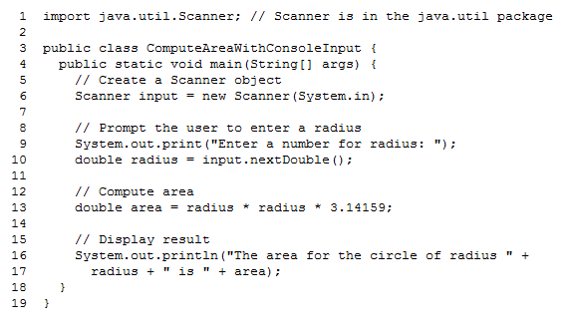
Reading in User Input

Slide 49
Pitfalls
As we have just seen, there are some pitfalls we need to be careful to avoid.
Reading in a String when we expect a double/int.
Reading in a double when we expect an int.
Reading in negative values when we expect non-negative values.
Towards the end of the class, we’ll look at exception handling, which will allow us to gracefully check for these errors and handle them in an elegant way.
Handle them without crashing!

Slide 50
Exercise 1b

Slide 51
Setting up your Java Environment
Although the lab computers have Java set up, you may want to work from your home computers/laptops.
I would suggest either JDK 7 or 8. The standard edition will be most appropriate.
http://www.oracle.com/technetwork/java/javase/downloads/jdk8-downloads-2133151.html
Be sure to download the JDK before downloading Eclipse.

Slide 52
Eclipse
Interactive Development Environment (IDE) for the Java language.
Allows us to more efficiently create, edit, and run our programs.
Eclipse’s debugger also allows us to more quickly find problems in our code.
One drawback in Eclipse is that it is sometimes too powerful…

Slide 53
Eclipse
Web link to download Eclipse
http://www.eclipse.org/downloads/
Fairly basic installation
Available for Windows, Mac, and Linux
Good tutorial on Eclipse Basics
Eclipse Supplement on D2L content tab.

Slide 54
Eclipse Demo
Let’s quickly create the Hello World example in Eclipse.

Slide 55
Exercise 1c

Slide 56
Lab1

Slide 57
Assignment 1

Slide 58
Programming Errors
Syntax Errors
Detected by the compiler
Runtime Errors
Causes the program to abort
Logic Errors
Produces incorrect result

Slide 59
Syntax Errors
public class ShowSyntaxErrors {
public static main(String[] args) {
System.out.println("Welcome to Java);
}
}

Slide 60
Runtime Errors
public class ShowRuntimeErrors {
public static void main(String[] args) {
System.out.println(1 / 0);
}
}

Slide 61
Logic Errors
public class ShowLogicErrors {
public static void main(String[] args) {
System.out.println("Celsius 35 is Fahrenheit degree ");
System.out.println((9 / 5) * 35 + 32);
}
}

